Slide 1
Electronics Systems (938II)
Lecture 2.3
Building Blocks of Electronic Systems – Latch, Flip-flop, Register

Slide 2
Sequential logic*
Sequential circuits that have “memory”, because its output depends on
Current input(s)
Previous output
Defined as current state
Already mentioned in previous lectures, the most notorious and used sequential circuit is the register
Store data

Slide 3
Sequential logic*
A register consists of one (or more)
D flip-flop (or DFF)
The D flip-flop is built upon the D latch
The D latch is built upon the SR latch, that can be easily built using CMOS gates

Slide 4
Sequential logic*
A register consists of one (or more)
D flip-flop (or DFF)
The D flip-flop is built upon the D latch
The D latch is built upon the SR latch, that can be easily built using CMOS gates
Let’s see how they are made, starting from the base, the SR latch!

Slide 5
SR latch*
Can be defined as a circuit that
Takes in input the signals S and R
S = Set
R = Reset
Has output(s)
According to the inputs name
When S = 1 and R = 0 → set command → output = 1
When S = 0 and R = 1 → reset (or clear) command → output = 0
Otherwise → keep previous output (= latch)

Slide 6

SR latch*
Recalling functionality
S = 1, R = 0 → output = 1
S = 0, R = 1 → output = 0
Otherwise → latch
Please, note that
$\overline{S}$ is the complement (or binary inverse) of S
$\overline{R}$ is the complement (or binary inverse) of R

Slide 7




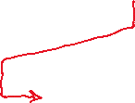


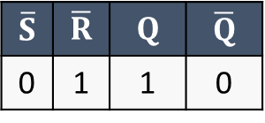
SR latch*
Recalling functionality
S = 1, R = 0 → output = 1
S = 0, R = 1 → output = 0
Otherwise → latch
Please, note that
$\overline{S}$ is the complement (or binary inverse) of S
$\overline{R}$ is the complement (or binary inverse) of R
$$\overline{S}$$ | $$\overline{R}$$ | $$Q$$ | $$\overline{Q}$$
0 | 1 | 1 | 0
Set command (as expected)

Slide 8

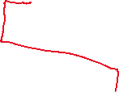


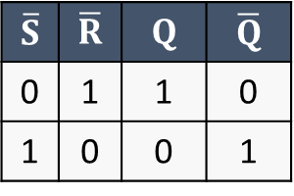

SR latch*
Recalling functionality
S = 1, R = 0 → output = 1
S = 0, R = 1 → output = 0
Otherwise → latch
Please, note that
$\overline{S}$ is the complement (or binary inverse) of S
$\overline{R}$ is the complement (or binary inverse) of R
$$\overline{S}$$ | $$\overline{R}$$ | $$Q$$ | $$\overline{Q}$$
0 | 1 | 1 | 0
1 | 0 | 0 | 1
Set command (as expected)
Reset command (as expected)

Slide 9


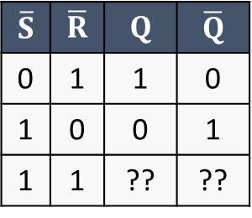
SR latch*
Recalling functionality
S = 1, R = 0 → output = 1
S = 0, R = 1 → output = 0
Otherwise → latch
Please, note that
$\overline{S}$ is the complement (or binary inverse) of S
$\overline{R}$ is the complement (or binary inverse) of R
$$\overline{S}$$ | $$\overline{R}$$ | $$Q$$ | $$\overline{Q}$$
0 | 1 | 1 | 0
1 | 0 | 0 | 1
1 | 1 | ?? | ??
Set command (as expected)
Reset command (as expected)

Slide 10
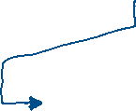
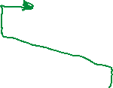
SR latch*
Assumption #1
Recalling functionality
S = 1, R = 0 → output = 1
S = 0, R = 1 → output = 0
Otherwise → latch
Please, note that
$\overline{S}$ is the complement (or binary inverse) of S
$\overline{R}$ is the complement (or binary inverse) of R
$$\overline{S}$$ | $$\overline{R}$$ | $$Q$$ | $$\overline{Q}$$
0 | 1 | 1 | 0
1 | 0 | 0 | 1
1 | 1 | ?? | ??
Set command (as expected)
Reset command (as expected)

Slide 11
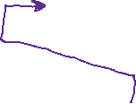
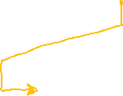
SR latch*
Assumption #2
Recalling functionality
S = 1, R = 0 → output = 1
S = 0, R = 1 → output = 0
Otherwise → latch
Please, note that
$\overline{S}$ is the complement (or binary inverse) of S
$\overline{R}$ is the complement (or binary inverse) of R
$$\overline{S}$$ | $$\overline{R}$$ | $$Q$$ | $$\overline{Q}$$
0 | 1 | 1 | 0
1 | 0 | 0 | 1
1 | 1 | ?? | ??
Set command (as expected)
Reset command (as expected)

Slide 12








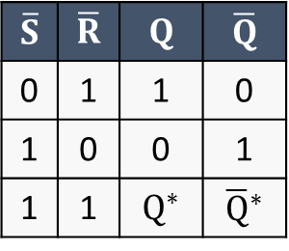

SR latch*
Recalling functionality
S = 1, R = 0 → output = 1
S = 0, R = 1 → output = 0
Otherwise → latch
Please, note that
$\overline{S}$ is the complement (or binary inverse) of S
$\overline{R}$ is the complement (or binary inverse) of R
Both assumptions hold. In other words, when $S=0$ ($\overline{S}=1$) and $R=0$ ($\overline{R}=1$), the latch keep the previous output(s): $Q^{∗}$ and ${\overline{Q}}^{∗}$
And in both cases $\overline{Q}$ = inverse of $Q$
$$\overline{S}$$ | $$\overline{R}$$ | $$Q$$ | $$\overline{Q}$$
0 | 1 | 1 | 0
1 | 0 | 0 | 1
1 | 1 | $Q^{∗}$ | ${\overline{Q}}^{∗}$
Set command (as expected)
Reset command (as expected)
Latch (as expected)

Slide 13




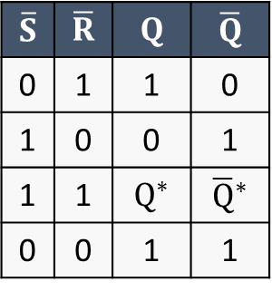

SR latch*
Recalling functionality
S = 1, R = 0 → output = 1
S = 0, R = 1 → output = 0
Otherwise → latch
Please, note that
$\overline{S}$ is the complement (or binary inverse) of S
$\overline{R}$ is the complement (or binary inverse) of R
In this case, $Q$ and $\overline{Q}$ are forced to 1, and, in addition, $\overline{Q}$ = $Q$ !!!
$$\overline{S}$$ | $$\overline{R}$$ | $$Q$$ | $$\overline{Q}$$
0 | 1 | 1 | 0
1 | 0 | 0 | 1
1 | 1 | $Q^{∗}$ | ${\overline{Q}}^{∗}$
0 | 0 | 1 | 1
Set command (as expected)
Reset command (as expected)
Latch (as expected)
Forbidden! ($\overline{Q}=Q$)

Slide 14
SR latch with Enable*
Let’s add and enable signal (EN) to the SR latch
SR latch with Enable

Slide 15

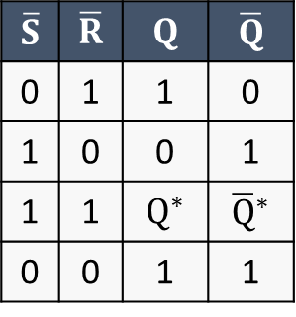
SR latch with Enable*
SR latch
Looking at the circuit
A = $\overline{S}$ of SR latch
B = $\overline{R}$ of SR latch
$$\overline{S}$$ | $$\overline{R}$$ | $$Q$$ | $$\overline{Q}$$
0 | 1 | 1 | 0
1 | 0 | 0 | 1
1 | 1 | $Q^{∗}$ | ${\overline{Q}}^{∗}$
0 | 0 | 1 | 1
SR latch truth table

Slide 16




SR latch with Enable*
SR latch
Looking at the circuit
A = $\overline{S}$ of SR latch
B = $\overline{R}$ of SR latch
If EN = 0, A = 1 and B = 1
$\overline{S}=1$ and $\overline{R}=1$ → SR latch: latch state
$$\overline{S}$$ | $$\overline{R}$$ | $$Q$$ | $$\overline{Q}$$
0 | 1 | 1 | 0
1 | 0 | 0 | 1
1 | 1 | $Q^{∗}$ | ${\overline{Q}}^{∗}$
0 | 0 | 1 | 1
SR latch truth table

Slide 17


SR latch with Enable*
SR latch
Looking at the circuit
A = $\overline{S}$ of SR latch
B = $\overline{R}$ of SR latch
If EN = 0, A = 1 and B = 1
$\overline{S}=1$ and $\overline{R}=1$ → SR latch: latch state
If EN = 1
$A =\overline{S∙EN}=\overline{S}+\overline{EN}=\overline{S}+\overline{1}=\overline{S}+0=\overline{S}$
$B =\overline{R∙EN}=\overline{R}+\overline{EN}=\overline{R}+\overline{1}=\overline{R}+0=\overline{R}$
It behaves the same as before!
$$\overline{S}$$ | $$\overline{R}$$ | $$Q$$ | $$\overline{Q}$$
0 | 1 | 1 | 0
1 | 0 | 0 | 1
1 | 1 | $Q^{∗}$ | ${\overline{Q}}^{∗}$
0 | 0 | 1 | 1
SR latch truth table

Slide 18



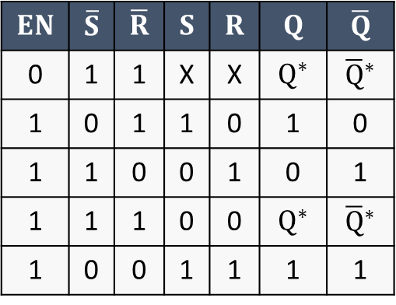

SR latch with Enable*
SR latch
If EN = 0, A = 1 and B = 1
$\overline{S}=1$ and $\overline{R}=1$ → SR latch: latch state
If EN = 1
It behaves the same as before!
$$EN$$ | $$\overline{S}$$ | $$\overline{R}$$ | $$S$$ | $$R$$ | $$Q$$ | $$\overline{Q}$$
0 | 1 | 1 | X | X | $Q^{∗}$ | ${\overline{Q}}^{∗}$
1 | 0 | 1 | 1 | 0 | 1 | 0
1 | 1 | 0 | 0 | 1 | 0 | 1
1 | 1 | 1 | 0 | 0 | $Q^{∗}$ | ${\overline{Q}}^{∗}$
1 | 0 | 0 | 1 | 1 | 1 | 1
$$\overline{S}$$ | $$\overline{R}$$ | $$Q$$ | $$\overline{Q}$$
0 | 1 | 1 | 0
1 | 0 | 0 | 1
1 | 1 | $Q^{∗}$ | ${\overline{Q}}^{∗}$
0 | 0 | 1 | 1
SR latch truth table

Slide 19
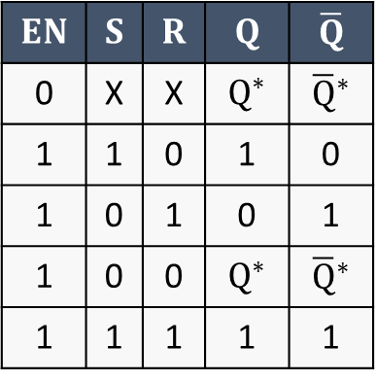

SR latch with Enable*
Recap
Truth table of SR latch with Enable
$$EN$$ | $$S$$ | $$R$$ | $$Q$$ | $$\overline{Q}$$
0 | X | X | $Q^{∗}$ | ${\overline{Q}}^{∗}$
1 | 1 | 0 | 1 | 0
1 | 0 | 1 | 0 | 1
1 | 0 | 0 | $Q^{∗}$ | ${\overline{Q}}^{∗}$
1 | 1 | 1 | 1 | 1
Latch (because ‘disabled’: EN = 0)
Set command (as expected: S = 1, R = 0)
Reset command (as expected: S = 0, R = 1)
Latch (as expected: S = 0 and R = 0)
Forbidden! ($\overline{Q}=Q=1$)

Slide 20
D latch*
Can be defined as a circuit that
Takes in input the signals D and EN
D = Data
EN = Enable
Has output(s)
Has then following functionality:
When EN = 0 → latch (keep previous output(s))
When EN = 1 → D sets the primary output (Q): Q = D

Slide 21
D latch*
It can be built using the SR latch with Enable
When EN = 0 → latch
When EN = 1 → D sets the primary output (Q): Q = D
D = 1 → Q = 1 → S = 1, R = 0
D = 0 → Q = 0 → S = 0, R = 1

Slide 22
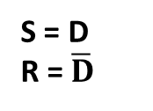
D latch*
It can be built using the SR latch with Enable
When EN = 0 → latch
When EN = 1 → D sets the primary output (Q): Q = D
D = 1 → Q = 1 → S = 1, R = 0
D = 0 → Q = 0 → S = 0, R = 1
S = D
R = $\overline{D}$

Slide 23
D latch*

Slide 24
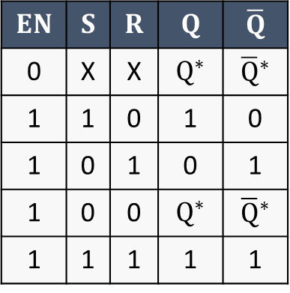
D latch*
$$EN$$ | $$S$$ | $$R$$ | $$Q$$ | $$\overline{Q}$$
0 | X | X | $Q^{∗}$ | ${\overline{Q}}^{∗}$
1 | 1 | 0 | 1 | 0
1 | 0 | 1 | 0 | 1
1 | 0 | 0 | $Q^{∗}$ | ${\overline{Q}}^{∗}$
1 | 1 | 1 | 1 | 1
SR latch with Enable
Truth table of SR latch with Enable

Slide 25


D latch*
$$EN$$ | $$S$$ | $$R$$ | $$Q$$ | $$\overline{Q}$$
0 | X | X | $Q^{∗}$ | ${\overline{Q}}^{∗}$
1 | 1 | 0 | 1 | 0
1 | 0 | 1 | 0 | 1
1 | 0 | 0 | $Q^{∗}$ | ${\overline{Q}}^{∗}$
1 | 1 | 1 | 1 | 1
SR latch with Enable
Truth table of SR latch with Enable
If EN = 0, it acts like before (SR latch with Enable)
If EN = 1
If D = 0 → S = 0 and R = 1 → Reset command (Q = 0)
If D = 1 → S = 1 and R = 0 → Set command (Q = 1)

Slide 26
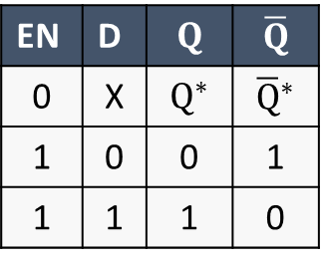
D latch*
(Gate-level)
(Truth table)
EN | D | $$Q$$ | $$\overline{Q}$$
0 | X | $Q^{∗}$ | ${\overline{Q}}^{∗}$
1 | 0 | 0 | 1
1 | 1 | 1 | 0

Slide 27
D latch*
(Gate-level)
(Truth table)
EN | D | $$Q$$ | $$\overline{Q}$$
0 | X | $Q^{∗}$ | ${\overline{Q}}^{∗}$
1 | 0 | 0 | 1
1 | 1 | 1 | 0
In addition, the forbidden condition of the SR latch never occurs
Thanks to the NOT gate, whatever the value of D, it happens that
Either S = 1 and R = 0
Or S = 0 and R = 1
It can never happen neither S = 0 and R = 0, nor S = 1 and R = 1

Slide 28
D latch*
(Gate-level)
(Truth table)
EN | D | $$Q$$ | $$\overline{Q}$$
0 | X | $Q^{∗}$ | ${\overline{Q}}^{∗}$
1 | 0 | 0 | 1
1 | 1 | 1 | 0
Logic symbol(s)
(RTL)

Slide 29
D flip-flop (or DFF)*
As any other flip-flop, it is built by cascading two latches (of the same type)
Two D latches in this case
Let’s see what happen by using a waveform
Q

Slide 30
D flip-flop (or DFF)*
Q

Slide 31











D flip-flop (or DFF)*
Q
When EN1 = CLK is 1, Q1 = D

Slide 32









D flip-flop (or DFF)*
Q
When EN1 = CLK is 1, Q1 = D
Otherwise, M latches and keep the last value of Q1

Slide 33
D flip-flop (or DFF)*
Q
Similarly, it happens for DFF2, but EN2 is the inverse of CLK
NOT gate
So, …

Slide 34












D flip-flop (or DFF)*
Q
When CLK = 0, EN2 = 1, Q = Q1
Q1 is the data input of S

Slide 35












D flip-flop (or DFF)*
Q
When CLK = 0, EN2 = 1, Q = Q1
Q1 is the data input of S
Otherwise, S latches and keep the last value of Q2

Slide 36


D flip-flop (or DFF)*
Q
In other words, the (primary) output of the DFF, i.e. Q, changes only at the falling edges of the signal CLK

Slide 37
D flip-flop (or DFF)*
CLK signal is typically called clock signal, and it is a periodic signal which oscillates between 0 and 1
Since the DFF is ‘activated’ by the (falling) edge of CLK, it said to be edge-triggered
In particular, negative-edge-triggered, since it is sensitive to the falling edge of clock signal

Slide 38
D flip-flop (or DFF)*
CLK signal is typically called clock signal, and it is a periodic signal which oscillates between 0 and 1
Since the DFF is ‘activated’ by the (falling) edge of CLK, it said to be edge-triggered
In particular, negative-edge-triggered, since it is sensitive to the falling edge of clock signal
Negative-edge-triggered D flip-flop
Q

Slide 39
D flip-flop (or DFF)*
CLK signal is typically called clock signal, and it is a periodic signal which oscillates between 0 and 1
Since the DFF is ‘activated’ by the (falling) edge of CLK, it said to be edge-triggered
In particular, negative-edge-triggered, since it is sensitive to the falling edge of clock signal
A positive-edge-triggered DFF (sensitive to the rising edge of the clock signal) can be obtained by inverting CLK at the input with another NOT gate
Negative-edge-triggered D flip-flop
Q

Slide 40
D flip-flop (or DFF)*
CLK signal is typically called clock signal, and it is a periodic signal which oscillates between 0 and 1
Since the DFF is ‘activated’ by the (falling) edge of CLK, it said to be edge-triggered
In particular, negative-edge-triggered, since it is sensitive to the falling edge of clock signal
A positive-edge-triggered DFF (sensitive to the rising edge of the clock signal) can be obtained by inverting CLK at the input with another NOT gate
Negative-edge-triggered D flip-flop
Positive-edge-triggered D flip-flop
Q
Q

Slide 41
D flip-flop (or DFF)*
Negative-edge-triggered D flip-flop
Positive-edge-triggered D flip-flop
Q
Q
This architecture was historically called Master-Slave architecture
Leftmost latch = Master, rightmost latch = Slave
It cannot be longer used for ethical reasons
Saying only because in case of further investigation you are very likely to find more matches using this historical name
Current name is Primary-Secondary (respectively)

Slide 42
D flip-flop (or DFF)*
Negative-edge-triggered D flip-flop
Positive-edge-triggered D flip-flop
Q
Q
Functional symbol = logic symbol
Functional symbol = logic symbol

Slide 43
D flip-flop (or DFF)*
Please note that the logic symbol of a flip-flop has an empty triangle on the signal used as clock!
This to indicate that that input is sensitive to the edge of the connected signal
Not to the level (as in the case of latches)
Positive-edge-triggered: active on the rising edge (of CLK)
Negative-edge-triggered: active on the falling edge (of CLK)
Positive-level-sensitive: active when EN = 1
Negative-level-sensitive: active when EN = 0

Slide 44
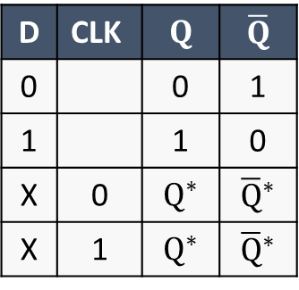
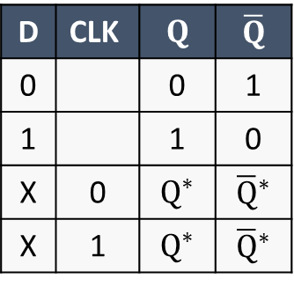
D flip-flop (or DFF)*
For this reason, typically the (triggering) edge of the clock signal is indicated in the truth table of the DFF
Negative-edge-triggered D flip-flop
Positive-edge-triggered D flip-flop
D | CLK | $$Q$$ | $$\overline{Q}$$
0 |  | 0 | 1
1 |  | 1 | 0
X | 0 | $Q^{∗}$ | ${\overline{Q}}^{∗}$
X | 1 | $Q^{∗}$ | ${\overline{Q}}^{∗}$
D | CLK | $$Q$$ | $$\overline{Q}$$
0 |  | 0 | 1
1 |  | 1 | 0
X | 0 | $Q^{∗}$ | ${\overline{Q}}^{∗}$
X | 1 | $Q^{∗}$ | ${\overline{Q}}^{∗}$

Slide 45
D flip-flop (or DFF)*
Typically, the positive-edge-triggered D flip-flop is the most used one
For this reason, it is generally indicated as just flip-flop
When one hears of a flip-flop, one implicitly refers to a D flip-flop
Additional solutions exist (for both edge-triggered DFFs) that count
An asynchronous reset (or clear): CLR
To reset the DFF regardless of clock signal (an its activating edge)
An asynchronous preset: PRE
To preliminary set to 1 the DFF output regardless of clock signal (an its activating edge)
They are typically active-low signals

Slide 46
Register*
Finally, we can define what is a Register
A register is a group of D flip-flops that store a binary value and share the same clock signal
The number of DFFs depends on the bit width of the value to be stored
N bits → N DFFs

Slide 47

Register*
Some examples
Omitting $\overline{Q}$
1-bit register
4-bit register

Slide 48
Register*
Functional symbol

Slide 49
Register*
Functional symbol
For simplicity, in RTL schematics you can find the following simplified symbols
I will do the same in the next lectures

Slide 50
Register*
Since the change of the register state occurs on a periodic signal (the clock), the register is a synchronous circuit
As well as DFF
Like DFFs, registers can also have an asynchronous reset!
Which is shared between all the DFFs composing the register

Slide 51
Exercise with SystemVerilog
Implementation of an 8-bit Register and simulation with Modelsim

Slide 52
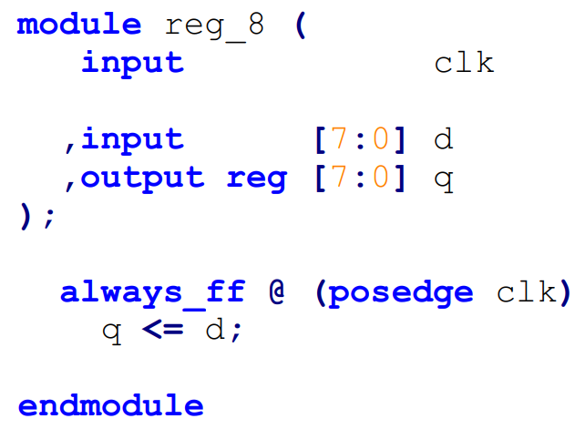


Exercise with SystemVerilog
Implementation of an 8-bit Register and simulation with Modelsim

Slide 53
Exercise with SystemVerilog*
Implementation of an 8-bit Register and simulation with Modelsim
Non-blocking assignment
reg signal
always_ff block
Triggering edge of the clock signal in the sensitivity list
operator <=

Slide 54












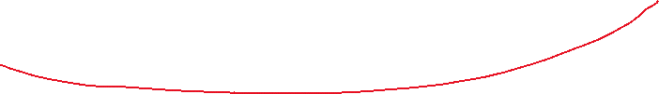
Exercise with SystemVerilog*
Implementation of an 8-bit Register and simulation with Modelsim
Non-blocking assignment
reg signal
always_ff block
Triggering edge of the clock signal in the sensitivity list
operator <=

Slide 55
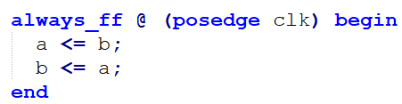
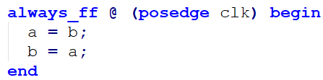


Exercise with SystemVerilog*
Non-blocking vs blocking assignment
Non-blocking assignment
Evaluated in sequence
But assigned only after all are evaluated
Blocking assignment
Assigned ‘immediately’

Slide 56

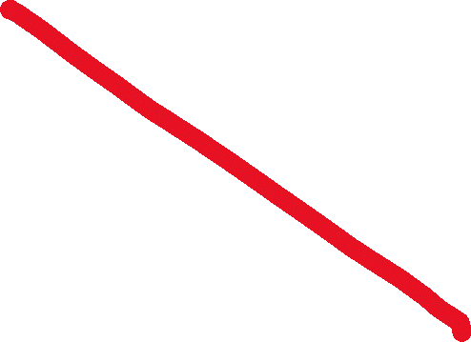
Exercise with SystemVerilog*
Non-blocking vs blocking assignment
Non-blocking assignment
Evaluated in sequence
But assigned only after all are evaluated
Blocking assignment
Assigned ‘immediately’

Slide 57

Exercise with SystemVerilog*
Non-blocking vs blocking assignment
Blocking assignment
Assigned ‘immediately’

Slide 58
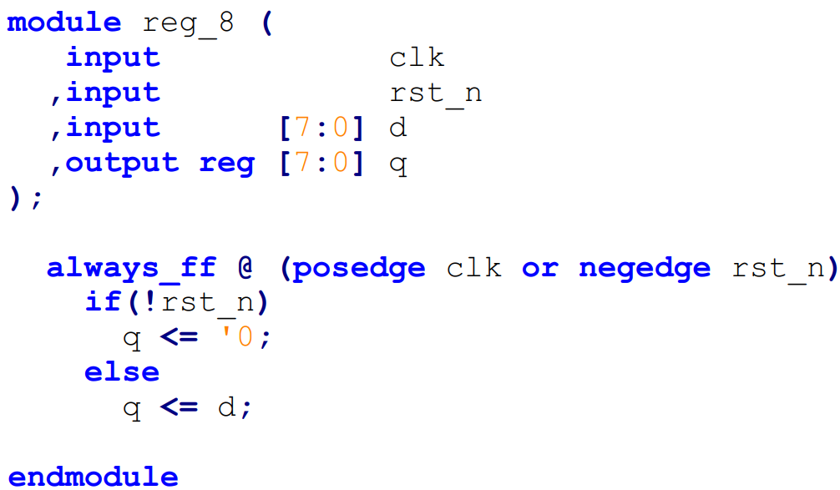





Exercise with SystemVerilog*
Implementation of an 8-bit Register and simulation with Modelsim
Adding asynchronous reset
port
signal (edge) inside sensitivity list
asynchronous w.r.t. to clock signal
must activate the always_ff block regardless of the clock
specify required edge
negedge → active-low
posedge → active-high

Slide 59


Exercise with SystemVerilog*
Implementation of an 8-bit Register and simulation with Modelsim
Adding asynchronous reset
port
signal (edge) inside sensitivity list
asynchronous w.r.t. to clock signal
must activate the always_ff block regardless of the clock
specify required edge
negedge → active-low
posedge → active-high

Slide 60
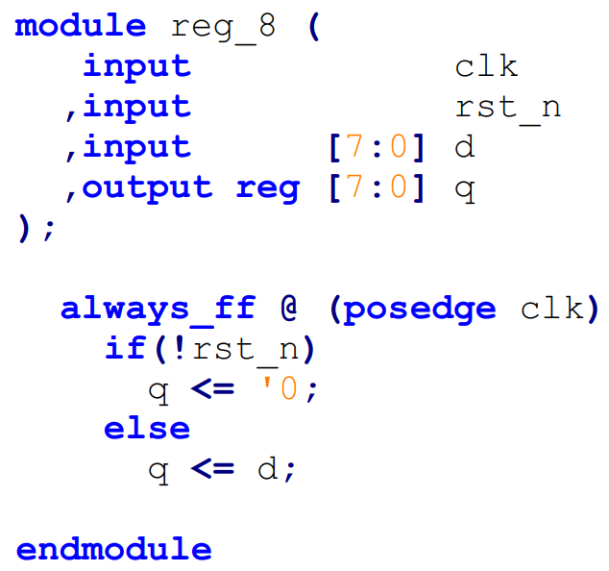


Exercise with SystemVerilog*
Implementation of an 8-bit Register and simulation with Modelsim
Adding synchronous reset
port
but nothing more
no signal (edge) in the sensitivity list
also reset is synchronous to clock, so reset must not activate the always_ff block

Slide 61
Exercise with SystemVerilog*
Register without reset
Register with asynchronous (active-low) reset
Register with asynchronous (active-high) reset
Register with synchronous (active-low) reset
Register with synchronous (active-high) reset

Slide 62
Exercise with SystemVerilog
Implementation of an 8-bit Register and simulation with Modelsim
You can find all the files about this exercise in the dedicated folder on the Team of the course
File > Electronics Systems module > Crocetti > Exercises > 2.3
Try to simulate on your own
However, I also included two .do files to automate the waveform and the simulation
wave.do and sim.do
Refer to README.txt file

